Slide 1
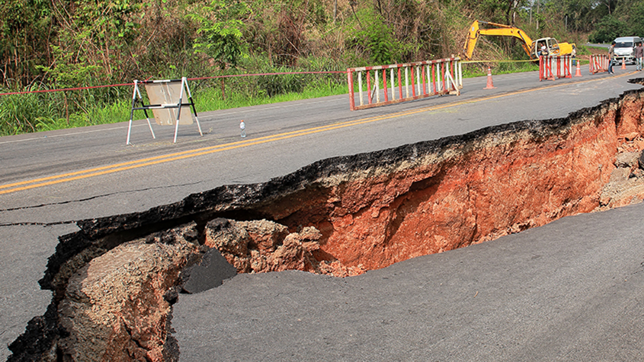
Predicting the Effects of Earthquakes Using Cloud-Based Machine Learning
Group – Assignment Group 2
1. Naveen Sita Reddy kovvuri (s02059263)
2. Sainath reddy mosali (s02061036)
3. Nithish kumar medabalimi (s02059513)
4. Lakshmi Kethineni (s02066249)
5. Tanay tamineni (s02065959)
6. Vidya rani vallala (s02066899)

Slide 2
Introduction
This project uses advanced machine learning models to predict earthquake features using PySpark and AWS SageMaker. Using cloud technology to provide scalability and reliability, our goal is to improve earthquake preparation with accurate projections through the analysis of previous seismic data.

Slide 3
Objectives
Predict Earthquake Features: By utilizing machine learning algorithms to examine previous seismic data, one can predict the important earthquake features such as the size, location, and timing of the Earthquake occurrence.
Cloud ML Capabilities: Deploy and improve machine learning models using AWS SageMaker and PySpark to show the efficiency and scalability of cloud computing and to show the benefits of cloud-based analytics in practical applications.

Slide 4
Significance
By using predictive analytics to enable early earthquake detection and response, this effort offers an important contribution to disaster preparedness. It highlights how technology may address important global issues by improving safety and reducing possible damage by utilizing cloud computing and machine learning models.

Slide 5
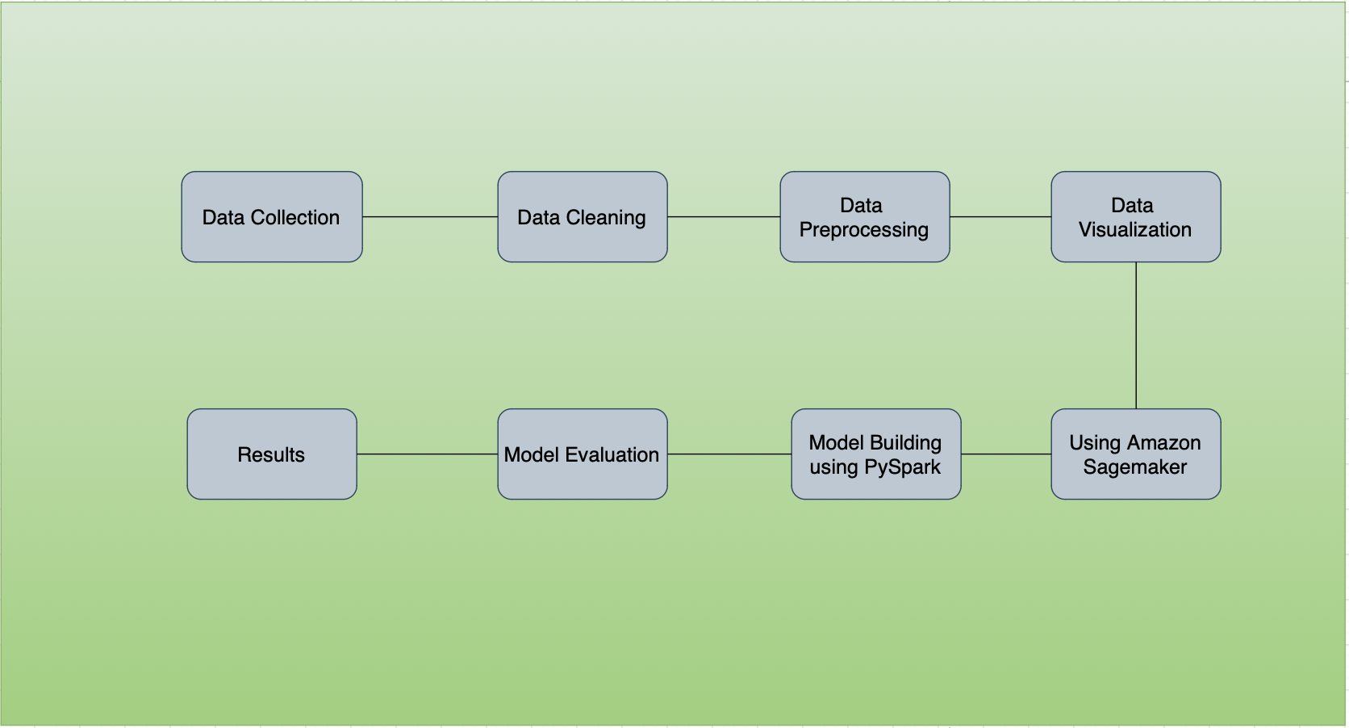
Workflow Diagram

Slide 6
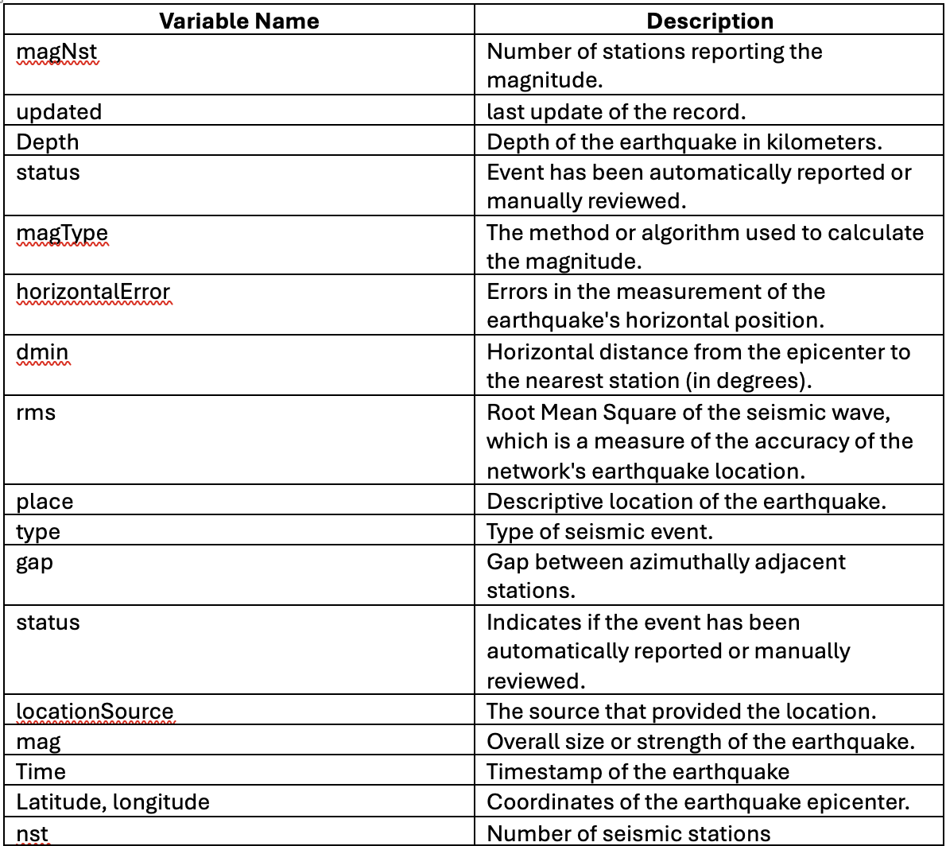
Dataset Description

Slide 7

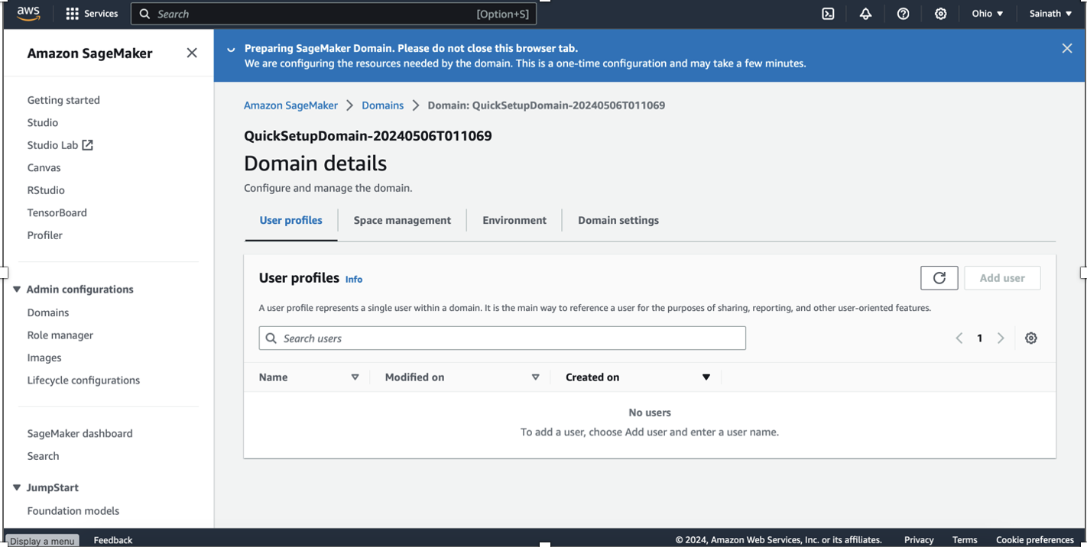
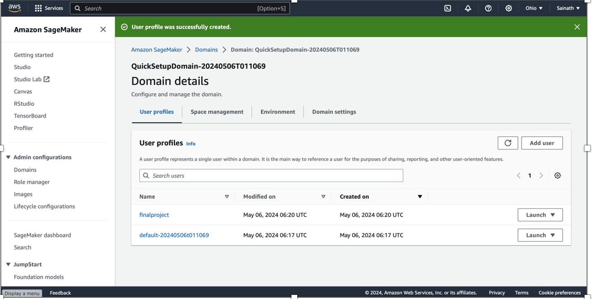
Amazon SageMaker setup
Here we are creating the new user profile using amazon SageMaker. We named it as finalproject and user profile is created successfully in the second screenshot.

Slide 8
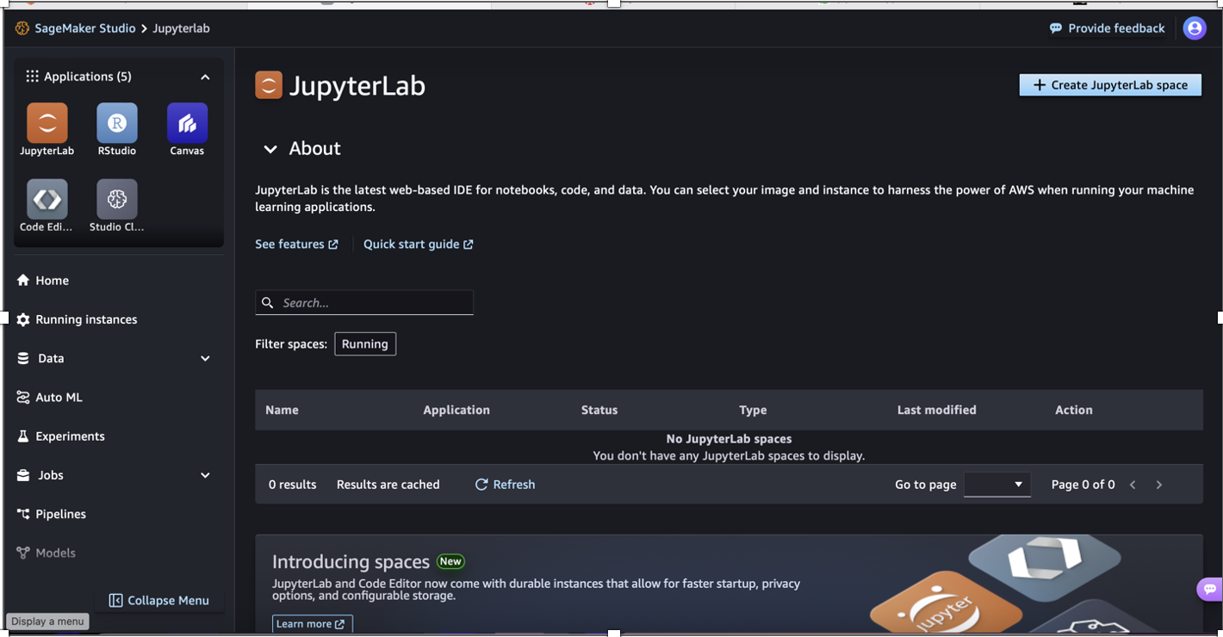
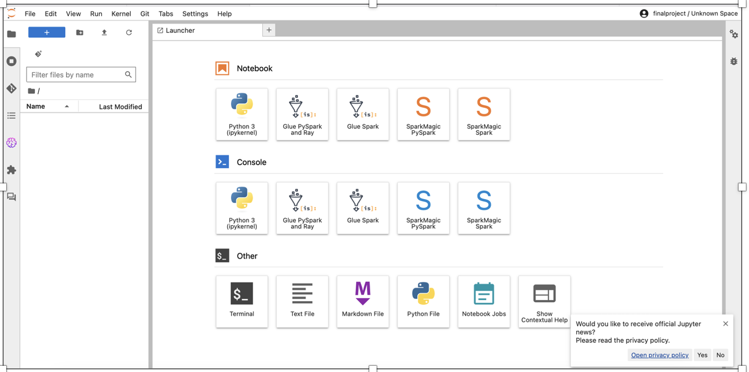
Accessing Jupyter Lab
After successfully creating the user profile, we are able to access the Jupyter lab by clicking Launch button.

Slide 9
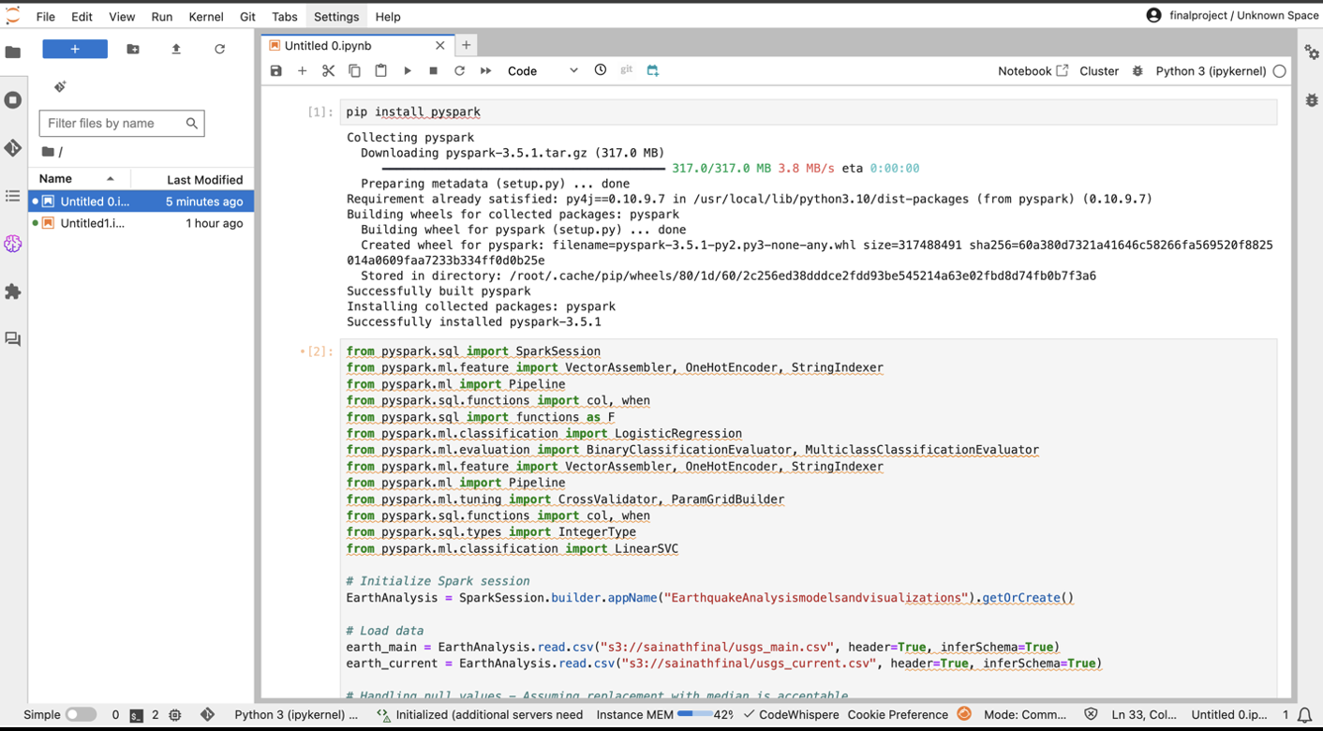
Cloud-Based Machine Learning with PySpark
Large-scale data processing, which is necessary for managing the huge and complex datasets generally involved in earthquake prediction, is made possible by PySpark. It is perfect for this project because of its effectiveness in data the translation, aggregation, and analysis. Installing Pyspark Library in Jupyter notebook.

Slide 10
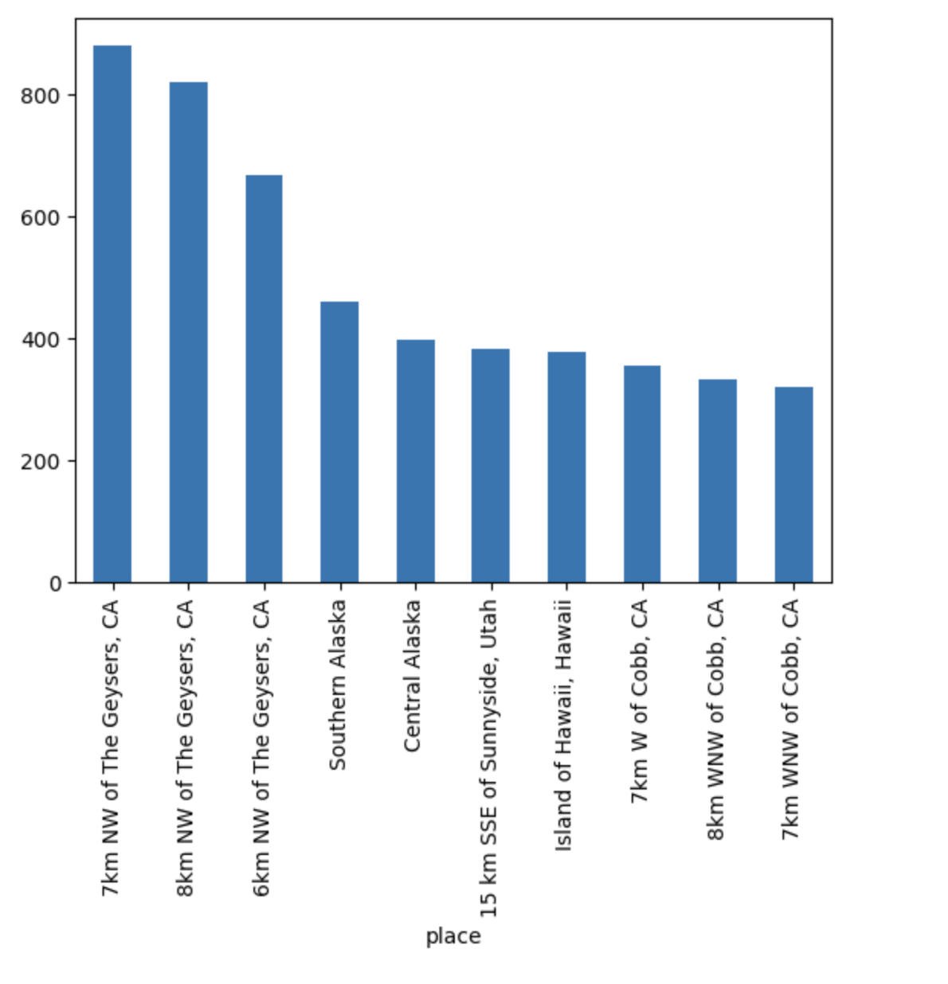
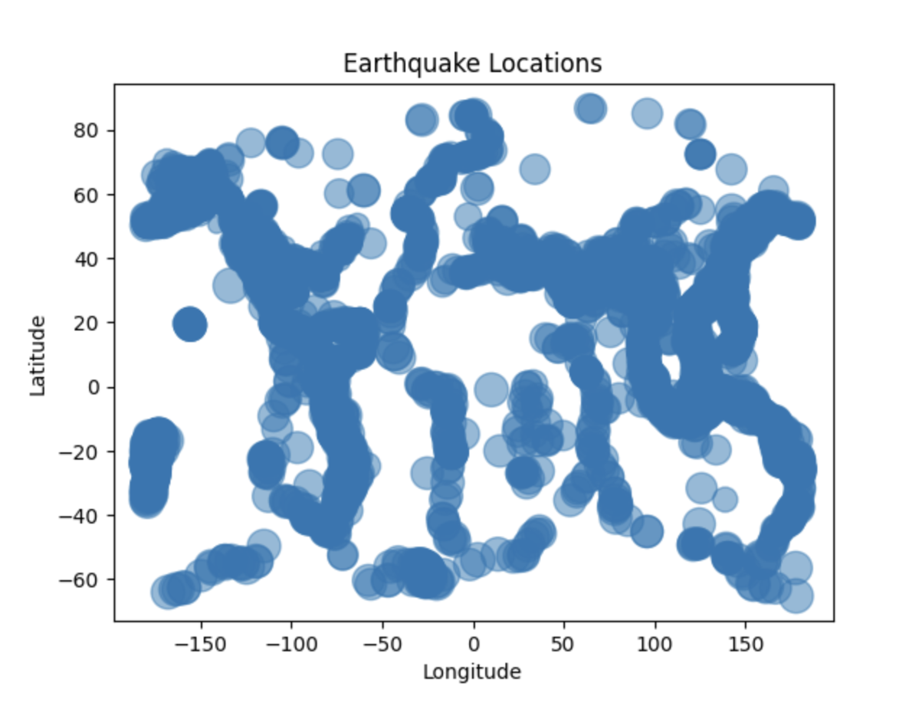
Data Visualization
The first graph shows the which place has the highest number of Earthquakes. The second graph display the location of earthquake.

Slide 11
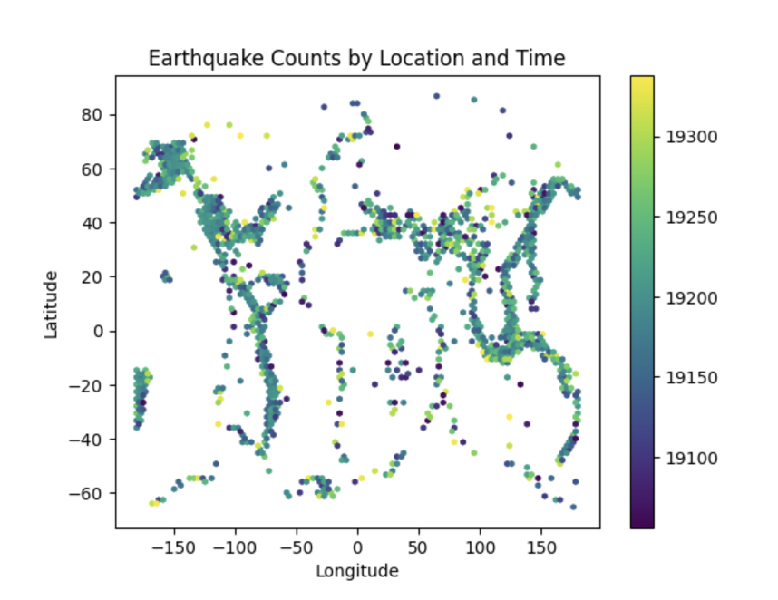
This graph counts the Earthquakes by location and time.

Slide 12
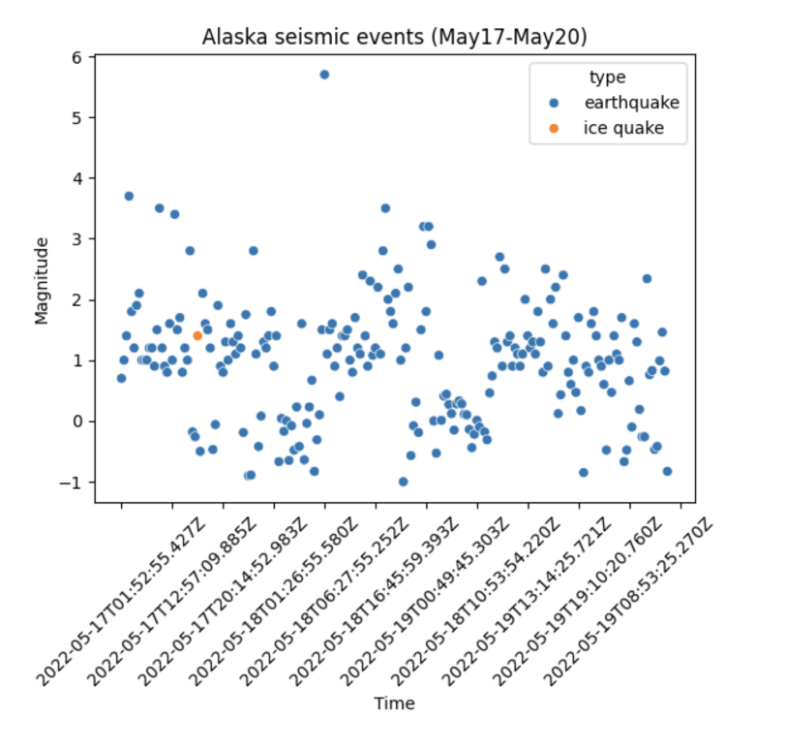
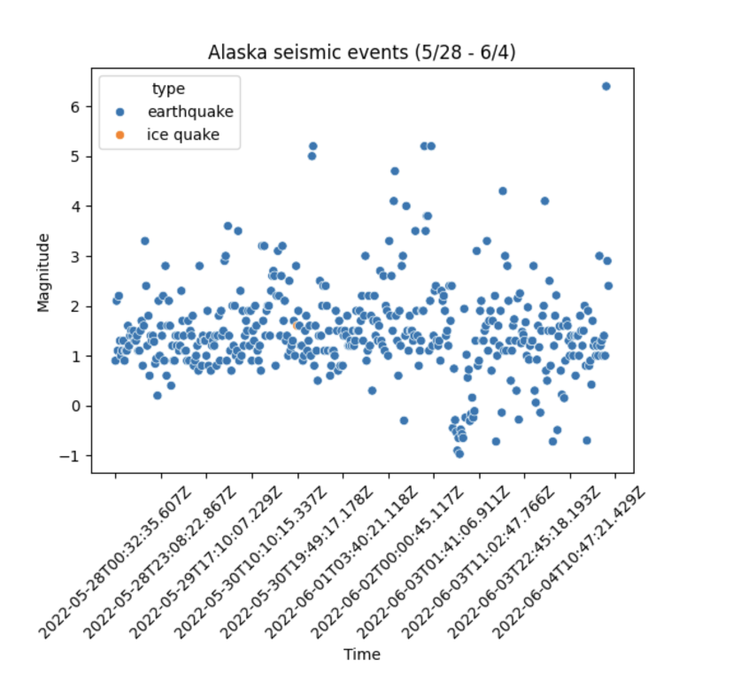
Using feature engineering technique to extract the state variable from the existing data. And here we are visualizing the Alaska state seismic events during particular time period

Slide 13
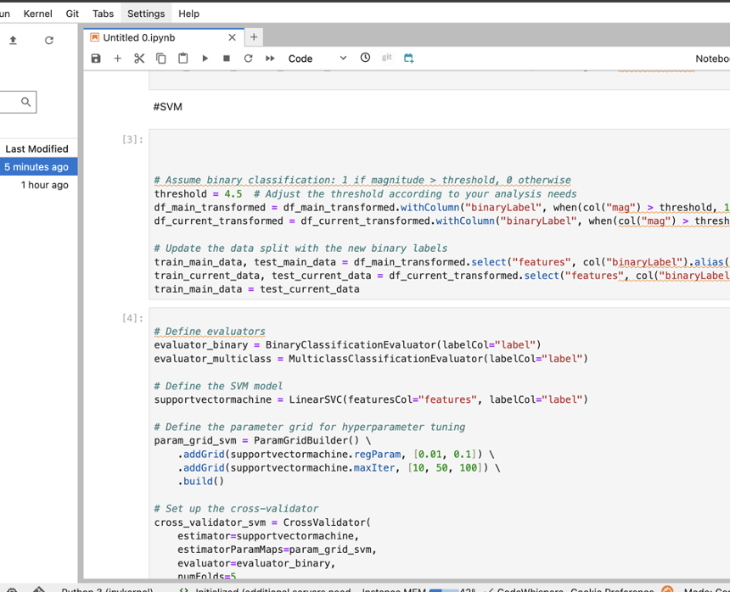
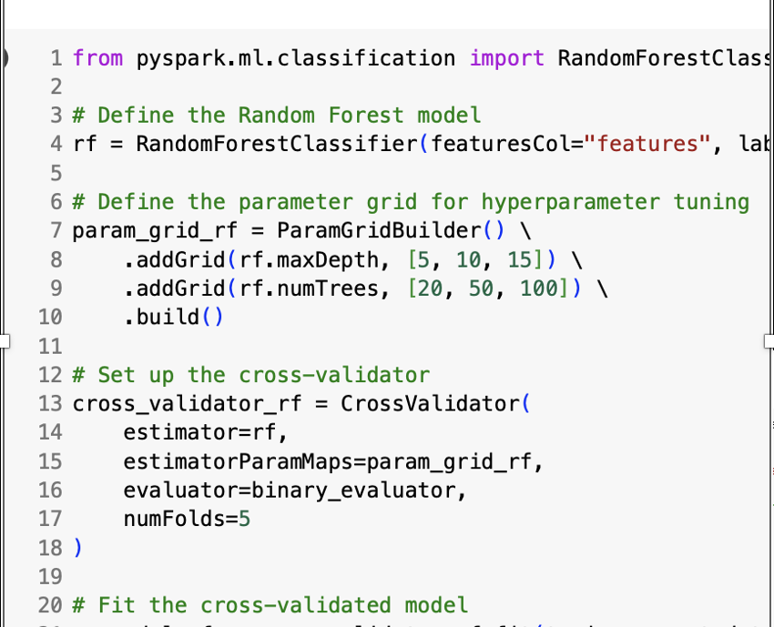
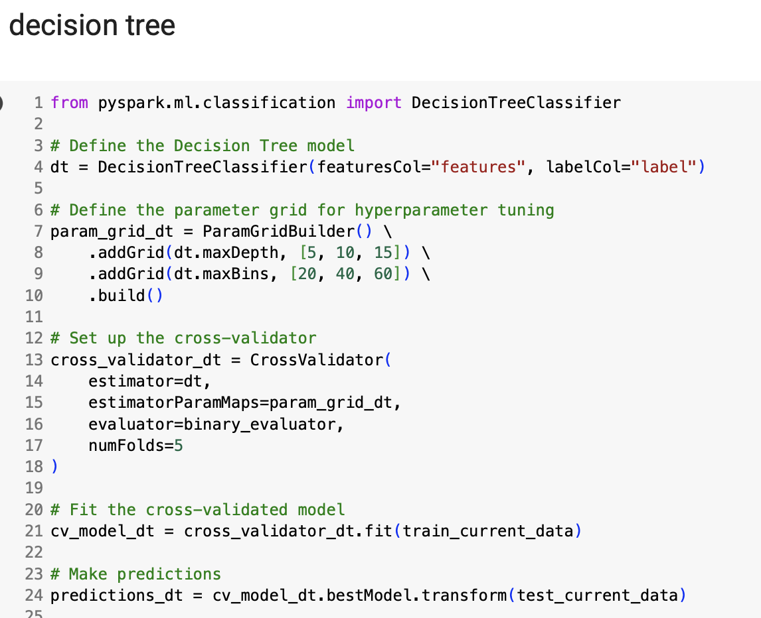
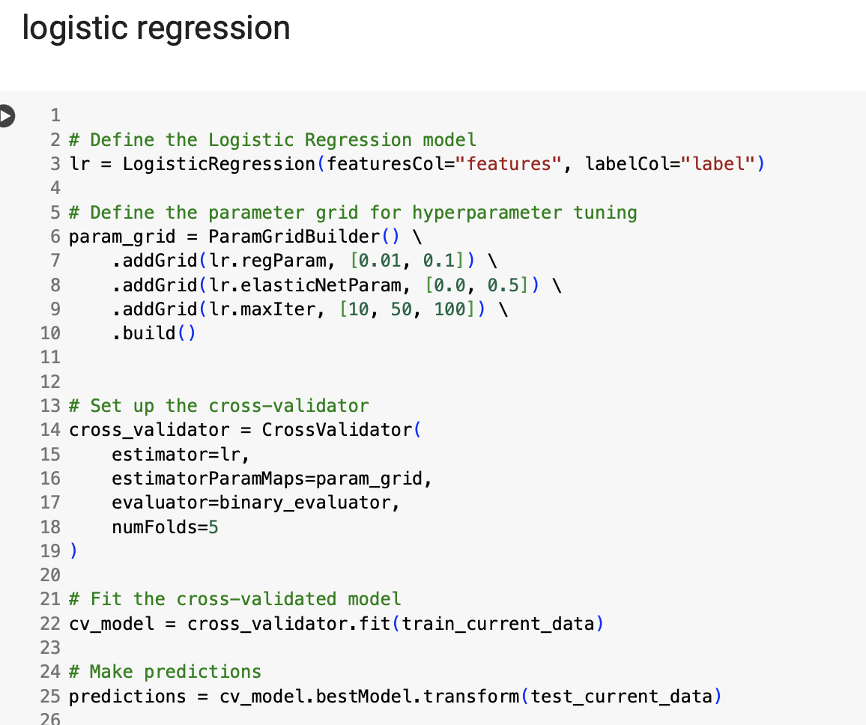
Machine Learning Models
Here are the four models we implemented in this project. We also include hyper parameter tuning for decision tree, logistic regression, random forest and SVM models.

Slide 14

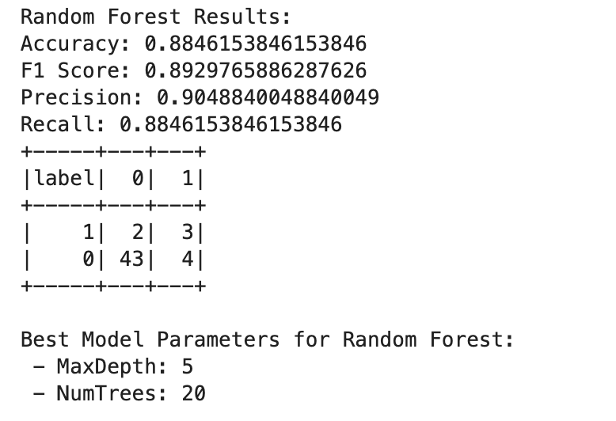
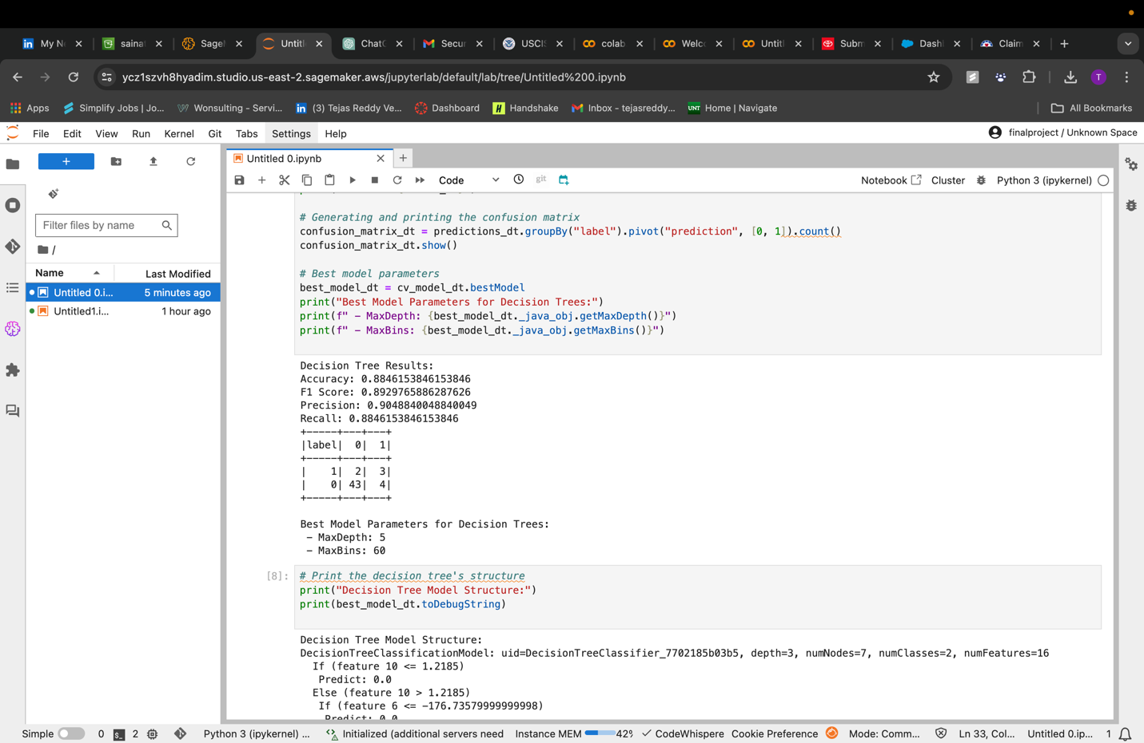


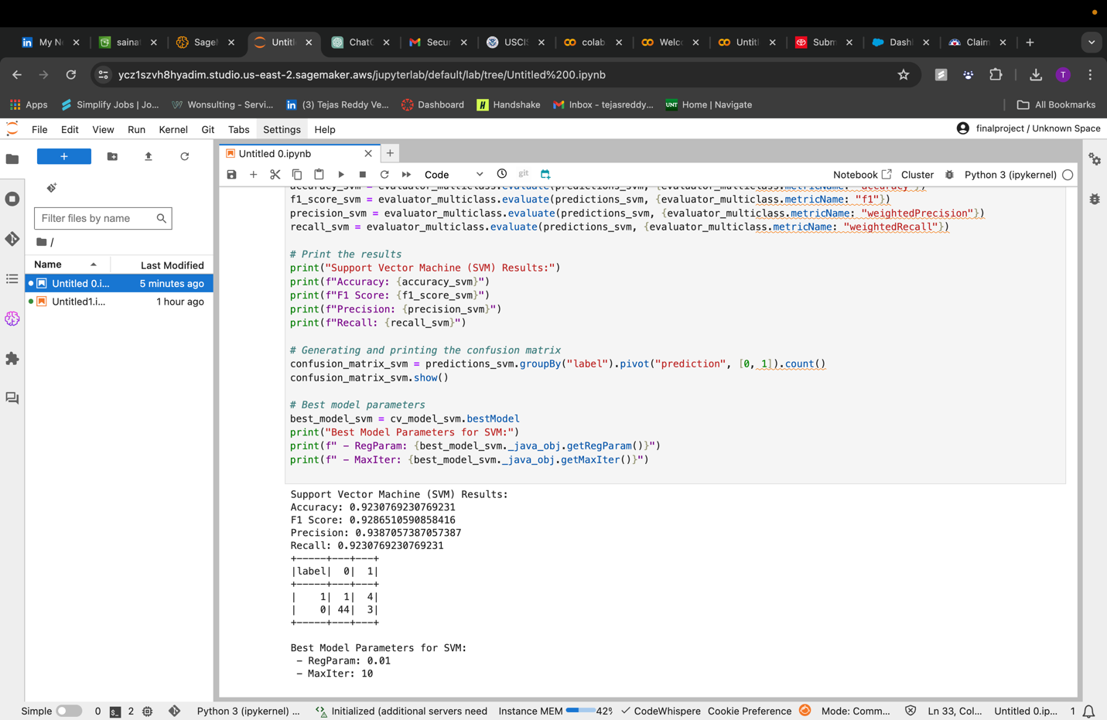
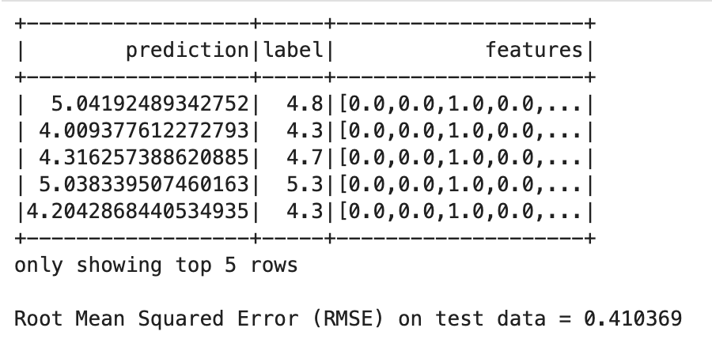

Model Evaluation
The results show the accuracy of every model and also display the F1-score, Precision, Recall for all the models.

Slide 15
Future work
Enhanced Model Complexity: Explore the inclusion of more complex models and the application of ensemble methods to improve the accuracy and resilience of predictions. The strengths of many models might be combined by using techniques like stacking and boosting.
Extend the dataset by including various data sources, such as historical damage reports, geological surveys, and real-time seismic sensor data, to improve model predictions and provide deeper insights into the impact of earthquakes.

Slide 16
Conclusion
In Conclusion, This project successfully shows the possible use of cloud-based machine learning for predicting earthquake characteristics with the use of PySpark and AWS SageMaker and increasing our ability to anticipate and respond to seismic events.

